Slide 1
ARO
Project Overview
CLUSTER UPGRADE
AUTOMATION
Sequential Y-stream upgrades with policy gates, live monitoring, validation, reporting and guaranteed session teardown.
Deterministic, guarded and auditable
OpenShift upgrade orchestration
6
15
10
ANSIBLE AUTOMATED
Lifecycle phases
Pre-upgrade checks
Post-upgrade checks
ONE-TOUCH FLOW
Designed for Ansible 2.7.17 and 2.14.18
Msp-Openshit_Ops
Notes:
[Sources] User-provided Documentation.md [/Sources]

Slide 2
Executive overview
What the automation delivers and why it matters
1
3
24
31
4
Authenticated session
Auto-remediation tiers
Single-purpose roles
Cross-phase facts
Final audit artifacts
Business outcome
Engineering outcome
Reduces manual handoffs across the upgrade lifecycle
Blocks unsafe mutations before upgrade initiation
Provides traceable evidence for governance and handover
Reduces Human Intervention/ Errors
Explicit Ansible conditions and oc CLI verification
Dual-version codebase with isolated kubeconfig
Structured logs, snapshots, HTML reports and email alerts
Notes:
[Sources] User-provided Documentation.md, sections 1, 3, 4.14 and 5.1 [/Sources]

Slide 3
Architecture and control boundaries
A four-tier model keeps orchestration deterministic and responsibilities separated
01
Operational entry
00_Run.sh validates inputs, dependencies, locks and run mode
02
Phase orchestration
main.yml coordinates policy, validation, hops, post-checks and OLM
03
Reusable automation
24 roles isolate health, remediation, upgrade, monitoring and reporting
04
Cluster APIs
CVO, MCO, OLM and Kubernetes APIs expose verifiable state
Control boundary: cluster mutations are permitted only after policy and prevalidation gates pass.
Notes:
[Sources] User-provided Documentation.md, sections 1, 2 and 4.14 [/Sources]

Slide 4
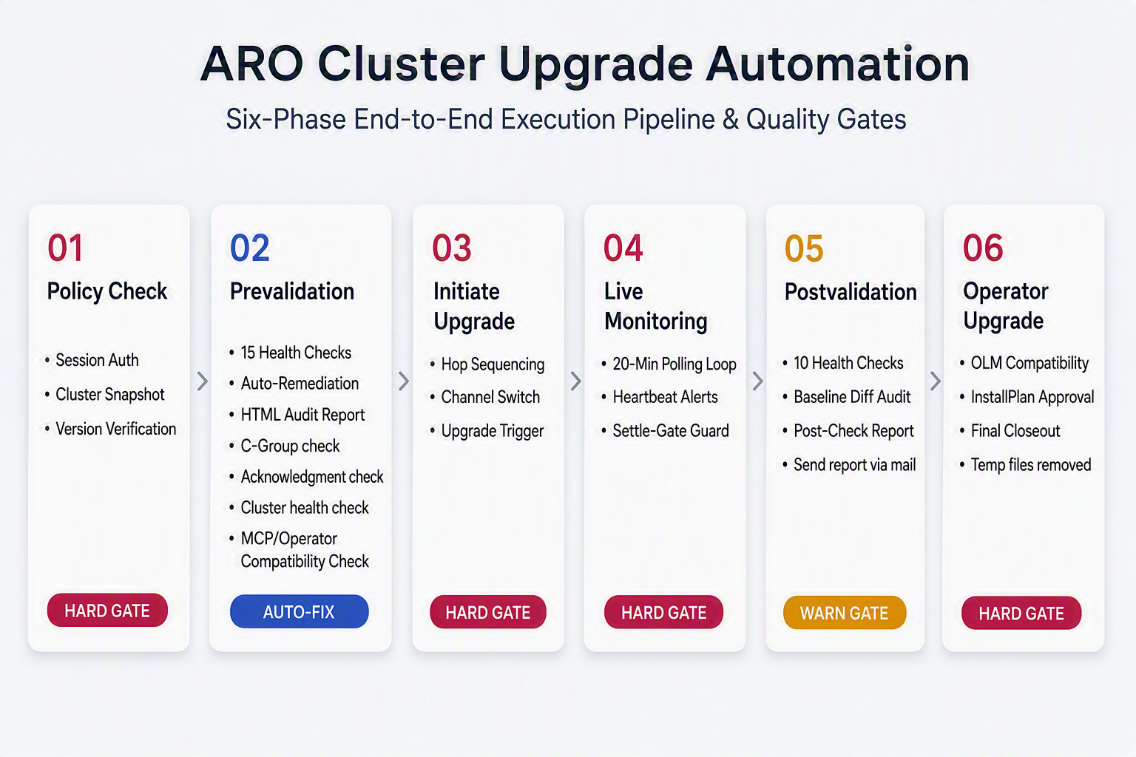
Notes:
[Sources] User-provided workflow image: cluster_upgrade_phases_minimal.jpg User-provided Documentation.md, phase descriptions 01 through 06 [/Sources]

Slide 5
Safety gates before cluster mutation
Policy validation, 15 health checks and bounded remediation protect the change window
POLICY CHECK
15-CHECK PREVALIDATION
AUTO-REMEDIATION
Authenticate once using an isolated kubeconfig
Capture baseline nodes, operators and routes
Verify the next update edge before writes
Reject malformed inputs and wrong API context
8 core HARD gates: API, etcd, CO, MCP, node, capacity, admin-acks and OLM compatibility
WARN advisories for CSR, storage, PDB and critical pods
CGroup compatibility assessed by target version and policy
Detect, authorize, apply, re-query and record
Tier 1: admin-acks, MCP unpause and cgroup controls
Tier 2: operator restart and stalled-node recovery require opt-in
Residual HARD failures stop the workflow
NO RESIDUAL HARD FAILURE
Notes:
[Sources] User-provided Documentation.md, Units 06, 07, 08a, 09 and section 5.1 [/Sources]

Slide 6
Sequential upgrade hops and live monitoring
Each target version is triggered, observed and settled before the next hop begins
1
2
3
4
5
Pre-hop settle
Guarded trigger
2-minute polling
Event notification
Settle gate
No active progression, degraded MCP or degraded operator
Channel and update edge re-verified; force path disabled by default
ClusterVersion, MCPs, nodes and operators tracked inline
State changes send immediate updates; heartbeat every 20 minutes
CV complete, CO healthy and every MCP fully updated
Hop settlement equation
ClusterVersion settled AND all ClusterOperators healthy AND all MachineConfigPools updated
Notes:
[Sources] User-provided Documentation.md, Units 10 and 11 [/Sources]

Slide 7
Validation, operator lifecycle and closeout
The workflow verifies technical health, configuration parity and OLM readiness before teardown
POST-UPGRADE
OLM OPERATORS
AUDIT CLOSEOUT
10 checks
Compatibility + validation
4 attachments
Final version, operators, MCPs, nodes, etcd, storage, core pods, alerts and baseline diff
Subscription channels, InstallPlan approvals, CSV rollout and validation-only bypass
Prevalidation, postvalidation, operator health report and complete run log
LOGOUT + TOKEN REVOCATION
Notes:
[Sources] User-provided Documentation.md, Units 12 and 13, sections 4.8 through 4.11 [/Sources]

Slide 8
Operational assurance and next steps
Production readiness is supported by compatibility, observability and governance controls
Assurance already built in
Recommended production path
Dual-version Ansible compatibility
jq 1.5-safe parsing and boolean normalization
Concurrency lock and deterministic exit codes
Block/rescue/always error handling
HTML reports, dual logs and email routing
01
Non-production soak testing
02
SRE walkthrough and failure drills
03
CAB evidence review and sign-off
04
Controlled production change window
Decision point: approve staged execution after soak-test evidence and operational handover are complete.
Notes:
[Sources] User-provided Documentation.md, Verification & Testing, Unit 17 and section 5 Next Steps [/Sources]

Slide 9
THANK YOU Any Questions ?
Notes:
[Sources] User-provided Documentation.md, Verification & Testing, Unit 17 and section 5 Next Steps [/Sources]

